Slide 1

MAVEN

Slide 3
TOMCAT

Slide 4
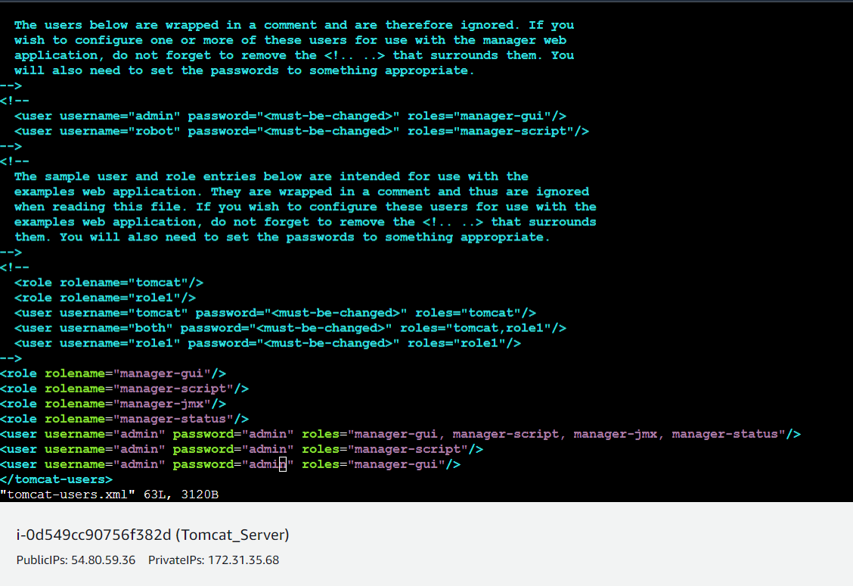
Update users information in the tomcat-users.xml file
goto tomcat home directory and Add below users to conf/tomcat-users.xml file

Slide 5
